Slide 1



Executive Team
The roadmap developed for the executive team aims to secure buy-in for the product vision
Executive Team
The executive team roadmap also seeks to maintain enthusiasm and support throughout the product cycle

Slide 2



Engineering
Be Specific
Focus on features, release dates, and milestones
Transparent
Engineers need as much specificity as possible, particularly about new features and release dates
Granular
Succinct
Likely to have a shorter time-frame than the executives’ roadmap
The engineering-oriented roadmap must still include product goals and themes, so that everyone understands the overall vision for the product .

Slide 3

Engineering
Tie to the broader project
Transparency
As much as possible
Developers need to understand deadlines and requirements even if they are less concerned with product vision and revenue potential
Include relevant milestones and requirements that other departments are facing
Graphics
65%
Marketing
65%
Finance
65%

Slide 4

High-level strategy
Include some sense of the “why” with a high-level strategy overview
Engineering
Include why, what, and when
Product vision
The overall product vision keeps everyone focused on the final goal
12
11
1
10
2
Engineers are less focused on product vision and revenue potential.
Even so, include high-level goals in the product roadmap
Features
The engineering team needs to understand the “what” of the product
9
3
8
4
Requirements
Product requirements will be a key component of the engineers’ roadmap
7
5
6
Release details
Timeline details keep the team focus on the “when” of the roadmap

Slide 5
Sales-Oriented Roadmap
Focus on features and customer benefits
Feature 01
How will the product help me to sell more?
Feature 02
How does this product improve on other options?
Feature 03
What developments should I share with prospects?
Benefit 04
How does the product benefit me as a sales rep?
Benefit 05
What benefits can I communicate to clients?

Slide 6
Sales-oriented roadmap
Use visuals to emphasize the benefits of the product
+4000% Growth
+310% Growth
+250% Growth
Themes
Group similar features into themes the reps can discuss with customers
Improvements
Emphasize how this product is an
improvement over others in the market
Solutions
Emphasize the customer problems that can be solved with this product

Slide 7
Sales-oriented roadmap
How do I benefit?
Wider market
Include information on how the product broadens the market
Increased sales
Sales reps need to understand how the product benefits them
Enhanced product
Specify the new features that enhance the product
Faster deals
Will the product make it easier to close deals?

Slide 8
Product roadmap components
Many components can be incorporated into a product roadmap
Roadmap 01
Roadmap 02
Roadmap 03
Once you have decided on the audience for your roadmap, start thinking about its components
The audience will determine the structure and information used in the roadmap
Some or all of the following will likely be components in the roadmap

Slide 9
Product initiatives
What is needed to meet the goals?
80%
60%
Strategies
Strategic initiatives show what needs to be accomplished to meet the goals
High-level
Initiatives are a high-level overview of what must be completed
40%
Themes
Initiatives include the broad themes of the work
The roadmap should include some sense of the high-level strategic initiatives that will need to be completed in order to fulfill the goals that have been laid out for the product.

Slide 10
Product roadmap components
Showcase the features
FEATURE 01
Showcase a new functionality
FEATURE 05
Specify when each feature will be delivered
FEATURE 02
Showcase an improved functionality
FEATURE 04
Specify how each feature will be delivered
FEATURE 03
Showcase the value to the users

Slide 11

Features
Use visuals to showcase the product features
Use a visual image to showcase the new or improved functionality that will deliver value to users; tie the features to the overall product strategy

Slide 12

User stories
A valuable component to use in a product roadmap
End-user perspective
Another way to incorporate features
Define from the end-user perspective
Tell the story
What the user wants
Why the user benefits
How the user benefits
Features
Interchangeable with ’features’
Focus on the added value
Add details

Slide 13
User stories
Particularly useful for sales-oriented or external user roadmaps
90%
75%
User 2
A roadmap featuring user stories can be particularly compelling for external audiences of clients and prospects.
VS
User 1
Stories that focus on the user experience are a good way to structure a roadmap intended for use by sales teams.

Slide 14
User stories
50%
a
Benefit
Always emphasize the benefits in any user story
Value
Specify the ways in which the product brings value to the user

Slide 15
Status
An essential component of any product roadmap
Status
Status
Goals
Initiatives
Per month
Per team
Every product plan should include an overview of progress
Use specific indicators for each component
Status
Status
Epics
Releases
Per story
Per quarter
Status indicators enhance the value of any roadmap
Show how the team is progressing against planned work

Slide 16
The roadmap should be updated
3
g
Update regularly
Update regularly
To capture market changes and new planning directions
To accommodate added resources or changes in priorities

Slide 17
Types of Roadmap
Designed with audience in mind
Portfolio Roadmap
Displaying releases for multiple products in a single view
Strategy Roadmap
Outlines the high-level efforts needed
Once you know your audience, and the specific components you want to include, you can think about the overall structure of your roadmap.
There are four general types of product roadmap, although the specifics can vary greatly.
Releases Roadmap
A way to plan for product releases
Features Roadmap
A timeline for delivering new features
Product
The structure you use will depend on the product and the audience

Slide 18
Product release roadmap
Focus on key phases and tasks
Keypoint 01
Keypoint 02
Keypoint 02
Keypoint 02
Keypoint 02
Communicate the delivery of critical features.
Coordinate the activities of multiple teams.
Keep everyone focused on what needs to be done.
Keep everyone focused on the next stages of the release roadmap.

Slide 19
Value
Tie each feature to the value it will provide to users
Features roadmap
Strategic importance
Delivery
Specify how each feature will be delivered
Brainstorming
Improvement
Tie each feature to the ways it will improve the user experience and solve users’ problems
Strategy
Education
Focus on the features that will deliver value to users.
Timeline
Specify when each feature will be delivered
Vision
Solution
New idea
Strategy
Tie the features to the overall product strategy
Users
Incorporate user stories in the features roadmap

Slide 20
A single owner has authority
b
d
One person...
...is the owner of the roadmap
Changes...
...can only be made by one person

Slide 21
Step One: Strategy
Make the case
Stakeholders
What does the product achieve?
Team
What are we building?
06
02
End-user
How will I benefit?
Capture the essence of what this product achieves.
03
Define the vision for the product.
05
01
Future
Where is this product headed?
Goals
Define the goals for the product.
04
Differentiate
How does this product stand out?

Slide 22
Step Two: Release
Internal or external
Decide whether the features you are focusing on will be presented to an internal or an external audience.
Internal
75%
Precise dates
External
25%
General dates

Slide 23
20%
Goals
Tie release dates to key business goals
Step Two: Release
Emphasize strategic importance when mapping out release dates for internal stakeholders.
56%
Business strategy
Remind internal stakeholders of overall business strategy
24%
Initiatives
Include key initiatives in internal release dates

Slide 24
Step Three: Prioritize
Remove the subjectivity
Business Profit
Subscribers
Annual revenue
$25,000
17,000
$3.9 million
Per day
Per day
First year
Clearly defined metrics, based on the strategy, help to score features.
Scoring features against specific goals takes the subjectivity out of the process.
Prioritize those features that will have the greatest impact.

Slide 25
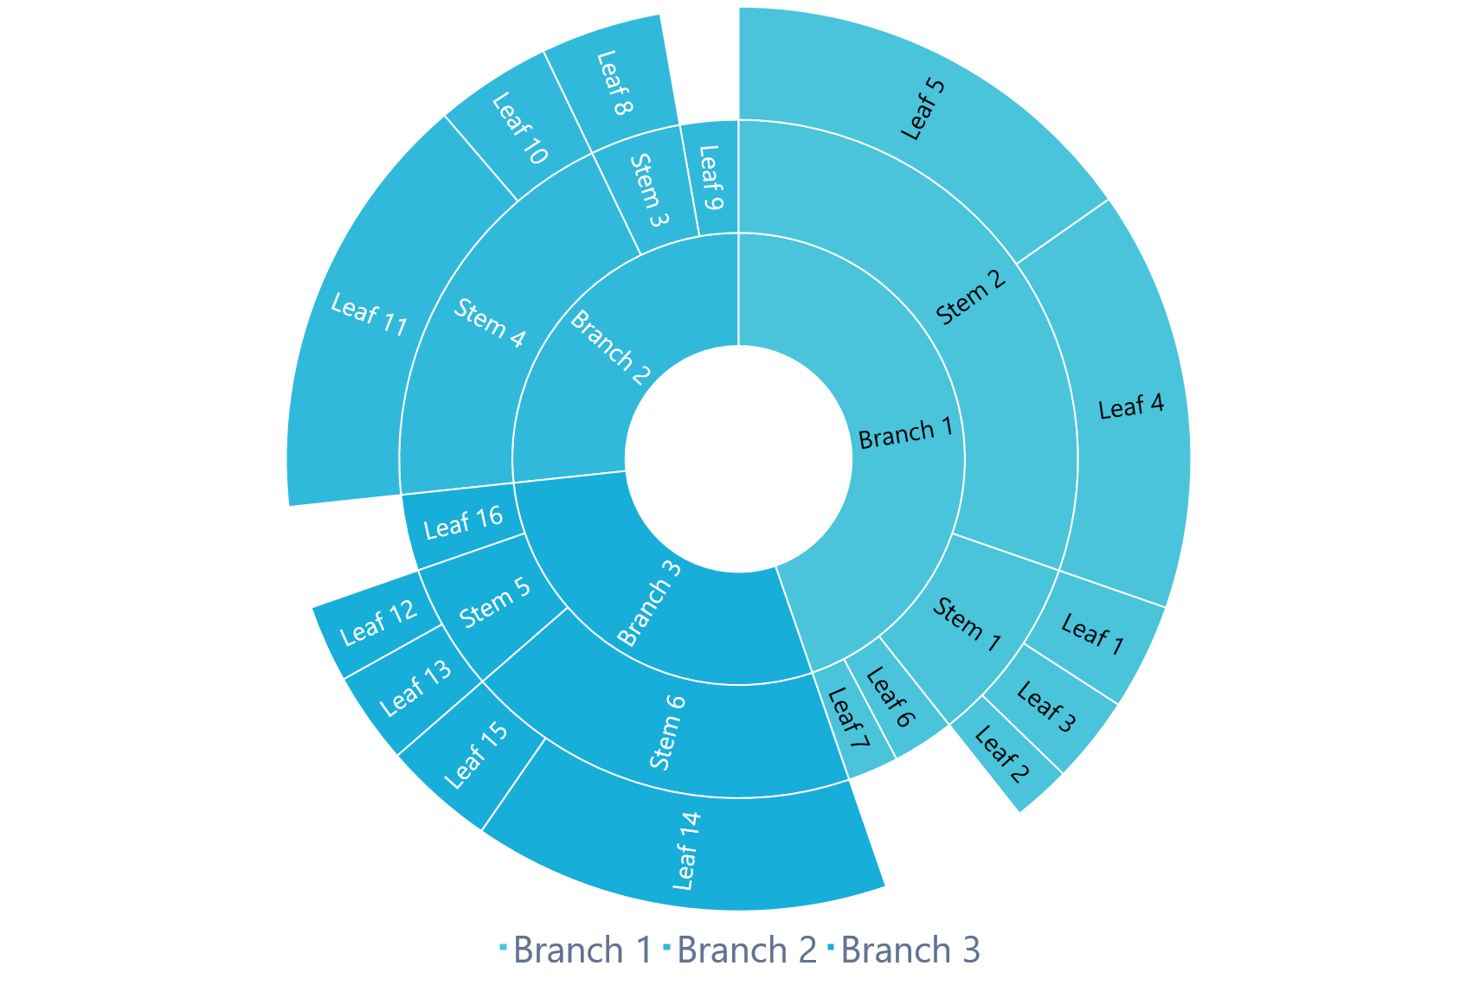
Traditional
An agile company needs a roadmap that can accommodate changes while still achieving goals
Waterfall
Business focused
A traditional or waterfall company needs a roadmap with long-term commitments and firm deadlines
Continuous
Agile
Customer focused

Slide 26
Agile companies
Focus on the customer
Agile companies practice continuous development and respond to rapid marketplace changes.
+250,000
Organic website clients
1k
400k
72 Hour
Product turnaround
2 Minute
Average response
130 User
Total Clients

Slide 27
Agile roadmap
An agile roadmap requires a different approach
72 Hour
Product turnaround
2 Minute
Average response
The challenge for an agile company is to create a roadmap that is both flexible and focused.
130 User
Total Clients

Slide 28
Focus on Strategy
01. Define the vision and the goals
02. Define the users and their relationship to the product
03. Define the outlook and the usage

Slide 29
Agile roadmap
Flexibility can be a challenge
Nicaragua
Costa Rica
Venezuela
Panama
Guyana
Suriname
Colombia
Ecuador
Peru
Brazil
Bolivia
Extensive flexibility can lead to unnecessary pivots in development and resources. An agile roadmap must be grounded in the product vision and strategy.
Chile
Paraguay
Uruguay
Argentina

Slide 30
Agile roadmap
Focus on the product vision
$9b
Fourth
Investment
$13b
Second
Investment
As in a traditional roadmap, an agile roadmap must start with the strategy: what are the product’s vision and goals? Articulate the problem being solved for the customer.
$26b
First Investment
$16b
Third Investment

Slide 31
Agile roadmap
Identify strategic themes
Features
Break the epic down into key features
Broad strategic themes or epics help to achieve the product’s goals.
User stories
Identify end-user stories to keep goals in sight

Slide 32
Agile roadmap
Identify strategic themes
Themes
75%
Initiatives and epics
If the team does need to change course, start be reevaluating and (if needed) changing the strategic initiatives before defining new features to work on.

Slide 33
Agile roadmap
Work cross-functionally
Harness all the relevant departments
Frequent communication and collaboration between groups
Get development input for realistic estimates of value and effort
Be aware of the longer timelines of groups like finance and legal

Slide 34
Agile roadmap
Tie user stories to strategic themes
Assess the strategy frequently
If goals change, so should priorities.
Break features into technical requirements and organize into sprints
Use vision, goals, and initiatives to break large themes into specific features

Slide 35
Avoid date traps
Tomorrow
Next week
Next month
Don’t specify dates for anything that is not yet in development
Keep a broad timeline
Not a work in progress? Don’t give any specific dates
Don’t give dates for anything that is not well defined or not well understood.

Slide 36
Planning
Roadmap gives a long-term view of the product cycle
A
B
C
Communication
Roadmap clarifies which teams need to be kept in the loop at each stage of the product’s development
Option
Option
Option
Single product roadmap
Plan across the timeline
28%
60%
92%
Daily
Roadmap clarifies daily expectations and deliverables for each team
Priorities
Single product roadmap establishes priorities at each stage
78%
45%
D
Goals
Roadmap is tied into business goals and strategies for clarity
E
Option
Option

Slide 37
Multiple products
Combine or no?
Some managers prefer to have separate roadmaps for each product, each with its own strategy, timeline, features, and priorities
Timeline
Maintaining separate timelines can disguise constraints
Constraints
Maintaining separate roadmaps makes it harder to pinpoint team constraints
Duplication
Multiple roadmaps can lead to duplicate effort on the part of planners and managers
Resources
Maintaining multiple roadmaps takes up more resources
95%
45%
70%
65%

Slide 38
Multiple products
Clarity is key
Vision
Clarify each product’s vision
32%
54%
When managing one roadmap for multiple products it is critical to have a very clear vision for each product and how it connects to the company strategy
Goals
Clarify each product’s goals and strategic purpose
92%
78%
Prioritize
Prioritize across products as well as within each product’s lifecycle
56%
98%
Strategy
Emphasize each product’s role in the wider strategy
78%
77%

Slide 39
Focus on priorities across teams.
Phasellus id ligula ut enim elementum
Score.
Prioritize.
Metrics.
Score features against strategic goals; remove subjectivity
Prioritize tasks and release date that have the greatest impact on the business strategy
Use metrics that reflect the wider business strategy .
#001.
#003.
#002.

Slide 40

Get 100+ extra slides from our “Product Roadmap” slide deck, many of other presentations, book summaries, resume templates, and other corporate resources when you join You Exec Plus.
Thank you, and be productive.

